Slide 1

PowerCo Customer Churn Analysis
This presentation explores the factors driving customer churn at PowerCo, a gas and electricity utility provider.
MW
Notes:
1

Slide 2
Project Overview
Objective
Key Questions
Investigate customer churn at PowerCo, focusing on the hypothesis that price sensitivity drives churn.
What factors influence customer churn? How does price sensitivity impact churn? What actionable insights can be derived to reduce churn?
Notes:
2

Slide 3
Data Understanding & Hypothesis Framing
Data Provided
Hypothesis
Customer data, pricing data, and churn data.
Churn is driven by customers' price sensitivity, measured by price elasticity of demand.
Notes:
3

Slide 4
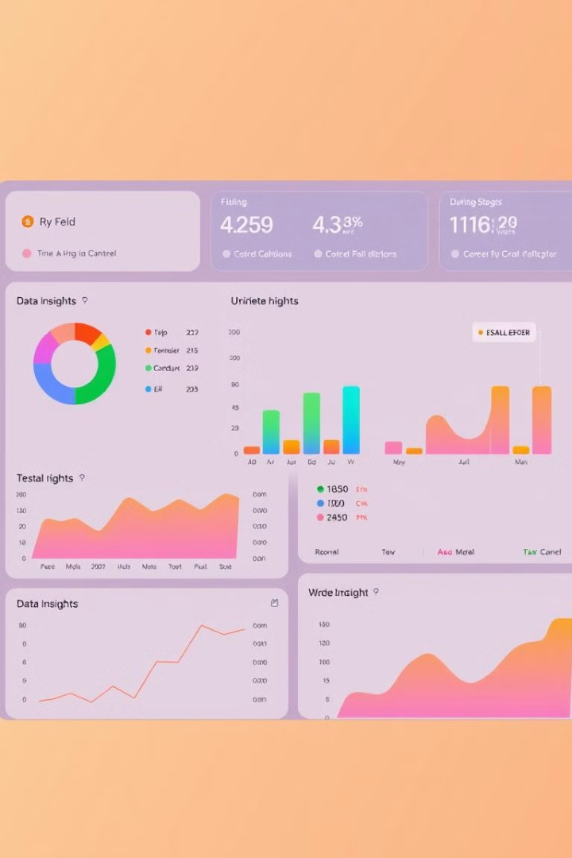
Exploratory Data Analysis (EDA)
Churn Rate
Sales Channels
~10% of customers churned, which is relatively low but still significant.
Some channels had higher churn rates, while others had none.
Consumption Patterns
Highly skewed distributions, with outliers in consumption data.
Notes:
4

Slide 5

Feature Engineering
Price Sensitivity Features
Difference between off-peak prices in December and January. Average and maximum price changes across peak, off-peak, and mid-peak periods.
Temporal Features
Tenure (duration of customer relationship). Months since contract activation, modification, and renewal.
Notes:
5

Slide 6
Modeling & Evaluation
Model Used
Evaluation Metrics
Random Forest Classifier (ensemble of 1000 decision trees).
Accuracy: 90.5%. Precision: 82%. Recall: 4.9%.
Notes:
6

Slide 7




Insights & Recommendations
Price sensitivity impacts churn, but it's not the primary driver.
Tenure, contract modifications, and renewals are strong predictors of churn.
Certain channels have higher churn rates, suggesting a need for targeted interventions.
Notes:
7

Slide 8

Next Steps
1
Model Improvement
Experiment with other algorithms. Optimize hyperparameters for better recall and precision.
2
Feature Engineering
Incorporate external data sources. Explore interaction features.
3
Business Impact
Implement churn prediction models in real-time. Develop personalized retention strategies.
Notes:
8

Slide 9

Conclusion
This project successfully identified key drivers of churn at PowerCo. While the model performs well in identifying non-churners, further improvements are needed to accurately predict churners. The insights and recommendations provided can help PowerCo reduce churn and improve customer retention, ultimately driving business growth.
Notes:
9

